Slide 1


Mapping Object-Oriented Database Models Into RDF(S)
By QIANG TONG
Prachi Randeria
1911105 B3

Slide 2

Mapping Object-Oriented Database Models Into RDF(S)
The Resource Description Framework and its schema RDF Schema are standard language proposed by the World Wide Web Consortium W3C to express the Web resource information and their semantics.
Mapping Object-oriented database models into RDF(S) will help the Semantic Web applications to access and process domain information and reuse existing domain information. On the other hand, we can also use the Semantic Web technology to solve some problems in modeling object-oriented database
By QIANG TONG

Slide 3
FORMAL DEFINITIONS

Slide 4
Object Oriented Database
OODM can be represented as a tuple (C, A, T , ISA, AGG, O) where,
C is a collection of classes, A is a collection of properties, and T is a collection of property basic data types : c = [..., a:t, a’:c’,...], where a, a’∈A, t∈T, c’∈C.
ISA ⊆ c1 × c2 : used to represent the inheritance relationship between subclass c1 and superclass c2
AGG ⊆ c1 × c2 : used to represent the aggregation relationship between an aggregate class c1and a constituent class c2
O is a collection of objects. The object o ∈ O is an instance of class c ∈ C, and each object has a unique object identifier
Notes:
© Copyright Showeet.com – Creative & Free PowerPoint Templates

Slide 5
Resource Description Framework
The RDF uses the triple statement <subject, predicate, object> to describe the data.
An RDF(S) model can be represented as a set of tuples (L, S), where:
L is an identifier set, which specifically includes a class resource identifier set C, an attribute resource identifier set P, a data type identifier set D, and an individual instance resource identifier set I.
S is a triple set of statements defined on the set of identifiers L.
Notes:
© Copyright Showeet.com – Creative & Free PowerPoint Templates

Slide 6
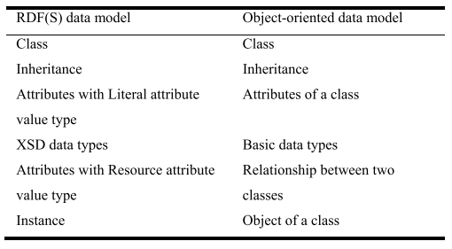
Comparison Between RDFS And OOD
Notes:
© Copyright Showeet.com – Creative & Free PowerPoint Templates

Slide 7

Mapping Rules…
Notes:
© Copyright Showeet.com – Creative & Free PowerPoint Templates

Slide 8

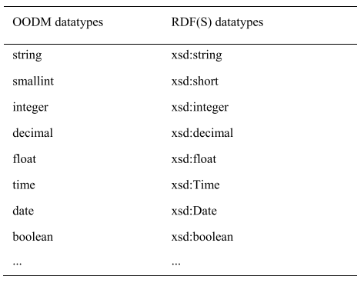
1
DATA TYPE MAPPING

Slide 9
Given identifiers C, A, T , O in the OODM, a corresponding RDF(S) resource identifier is created for each identifier.
The RDF(S) resource identifier is uniquely processed by naming a non-unique OODM element.
2
IDENTIFIER MAPPING

Slide 10
Given a class c ∈ C in OODM, create an RDF(S) class:
<rdfs:Class rdf:ID= “c”/>
3
CLASS MAPPING

Slide 11
Given the attribute constraint
c = [..., a : t, a’ : c’,...] of the class c ∈ C,
where a, a’ ∈ A, t ∈ T , c’ ∈ C,
Then create corresponding RDF(S) attributes for attributes a and a’ respectively
<rdf:Property rdf:ID = ‘‘a’’>…</rdf:Property> and <rdf:Propertyrdf:ID = ‘‘ a’ ’’> . . . </rdf:Property>,
and restrict the domain of the attribute a to the corresponding RDF(S) class of the class c, the range to the corresponding RDF(S) data type of t, the domain of the attribute a’ to the corresponding RDF(S) class of the class c, and the range is the corresponding RDF(S) class of class c’.
4
ATTRIBUTE MAPPING OF CLASS

Slide 12
OOD- Professor = [name: string, supervise: Student]
<rdfs:Class rdf:ID = ‘‘Professor’’/>
<rdfs:Class rdf:ID = ‘‘Student’’/>
<rdf:Property rdf:ID = ‘‘name’’ >
<rdfs:domain rdf:resource= ‘‘#Professor’’/>
<rdfs:range rdf:resource = ‘‘&xsd:string’’/>
</rdf:Property>
<rdf:Property rdf:ID = ‘‘supervise’’>
<rdfs:domain rdf:resource= ‘‘#Professor’’/>
<rdfs:range rdf:resource = ‘‘#Student’’/>
</rdf:Property>
4
ATTRIBUTE MAPPING OF CLASS

Slide 13
Given an inheritance ISA ⊆ c1 × c2
which is defined in classes c1,c2 ∈ C in OODM, and then create the appropriate RDF(S) subclass/superclass constraint
<rdfs:Class rdf:ID= ’’c1’’>
<rdfs:subClassOf rdf:resource = ‘‘#c2’’/>
</rdfs:Class>.
5
CLASS INHERITANCE MAPPING

Slide 14
OODM class Inheritance
ISA ⊆ Undergraduate_Student×Student
(this inheritance class represents the Undergraduate_Student is a subclass of Student), and the RDF(S) built according to the rule 5 contains the following subclass/superclass constraints:
<rdfs:Class rdf:ID = ‘‘Student’’/>
<rdfs:Class rdf:ID = ‘‘Undergraduate_Student’’>
<rdfs:subClassOf rdf:resource=‘‘#Student’’/>
</rdfs:Class>
5
CLASS INHERITANCE MAPPING

Slide 15
Given an aggregation AGG ⊆ c1 × c2 which is defined in classes c1, c2 ∈ C in OODM, and then create a property named pagg and the constrains of the property as follows:
<rdfs:Class rdf:ID = ‘‘c1’’/>
<rdfs:Class rdf:ID = ‘‘c2’’/>
<rdf:Property rdf:ID = ‘‘pagg’’>
<rdfs:domain rdf:resource = ‘‘#c1’’/>
<rdfs:range rdf:resource = ‘‘#c2’’/>
</rdf:Property>
6
AGGREGATION MAPPING

Slide 16
Given the object instance o ∈ O of class c ∈ C in OODM, and create the corresponding RDF(S) constraint
<rdf:Description rdf:ID =‘‘o’’>
<rdf:type rdf:resource = ‘‘#c’’/>
</rdf:Description>
7
OBJECT INSTANCE MAPPING

Slide 17
Given an object instance of class c ∈ C = [. . . , a : t, a’: c’. . .] in OODM, o = [. . . , a : v, a’: o’. . .],
Where, a,a’ ∈ A, t ∈ T , c’ ∈ C, v is the value of the object instance o on the attribute a, o’ is the object instance of the class c’ ∈ C.
Based on the Rule 7, we further increase the constraint
<rdf:Description rdf:ID = ‘‘o’’>
<rdf:type rdf:resource = ‘‘#c’’/>
< a rdf:datatype=‘‘t’’> v </a >
< a’ rdf:resource= ‘‘#o’ ’’/>
</rdf:Description>.
8
ATTRIBUTE MAPPING OF CLASS

Slide 18
Professor = [name:string, supervise: Student]
p1 = [name: John, supervise: s1],
Where, s1 is an object instance of class Student
<rdf:Description rdf:ID = ‘‘s1’’>
<rdf:type rdf:resource = ‘‘#Student’’/>
</rdf:Description>
<rdf:Description rdf:ID = ‘‘p1’’>
<rdf:type rdf:resource = ‘‘#Professor’’/>
<name rdf:datatype=‘‘&xsd:string’’>John</name>
<supervise rdf:resource = ‘‘#s1’’/>
</rdf:Description>
8
ATTRIBUTE MAPPING OF CLASS

Slide 19
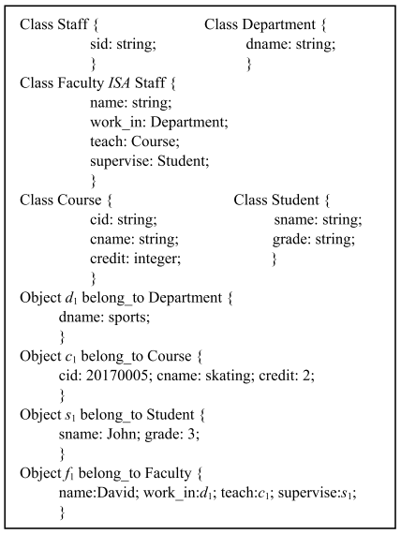
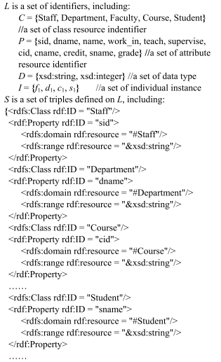
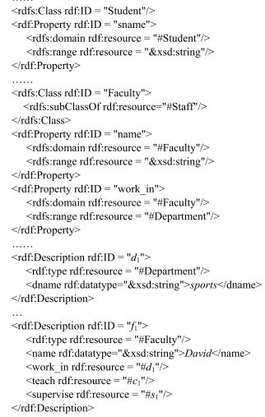

Slide 20
Limitations…
Due to the limitations of the expressiveness of RDF(S) itself, some semantic information in some object-oriented database models cannot be directly mapped to RDF(S) during the construction process.
Since RDF(S) cannot represent the method invocation process between classes, the methods contained in the OODM classes cannot be represented during the mapping process.
RDF(S) cannot represent disjoint constraints, the disjoint constraints in OODM cannot be directly represented in the mapping process, and can only be achieved through the use of RDF(S) extension language.
Notes:
© Copyright Showeet.com – Creative & Free PowerPoint Templates

Slide 21
QUERY CONVERSION
The standard query language for RDF(S) is SPARQL
A SPARQL query generally consists of five parts:
Declaration: PREFIX foaf: <http://xmlns.com/foaf/0.1>
Result set: SELECT ?name
Data set: FROM <http://example.org/foaf/aliceFoaf>
Graph pattern: WHERE {?x foaf:name ?name.}
Result modification: ORDER BY ?name
Example: querying the student whose grade is 3 in the OODM, which can be expressed by the mapped SPARQL query language:
SELECT ?x
WHERE {{?x rdf:type student.},
{?x grade ‘‘3’’^^xsd:integer.} }
Notes:
© Copyright Showeet.com – Creative & Free PowerPoint Templates

Slide 22
CONCLUSION
This paper compares and analyzes the characteristics of the object-oriented database model OODM and RDF(S), proposes a RDF(S) construction method based on OODM, and realizes the mapping from OODM to RDF(S).
Based on the formal definition of OODM and RDF(S), the mapping method from OODM to RDF(S) is proposed, and the detailed rules are given.
The work of this paper will help the Semantic Web application to access and process domain information and to reuse and share existing domain information.
Notes:
© Copyright Showeet.com – Creative & Free PowerPoint Templates

Slide 23
BIBLIOGRAPHY
http://www.w3.org/TR/xmlschema-2/
http://www.w3.org/TR/2014/NOTE-rdf11-primer-20140225/
https://en.wikipedia.org/wiki/Semantic_Web
https://en.wikipedia.org/wiki/World_Wide_Web_Consortium

Slide 24

Thank You!

